Slide 1
Question 4 : Portfolio Commentary
Liam Andrew Beattie - 22562435

Slide 2
Question 4: Portfolio Commentary

Slide 3
SnakeOil Capital

Slide 4
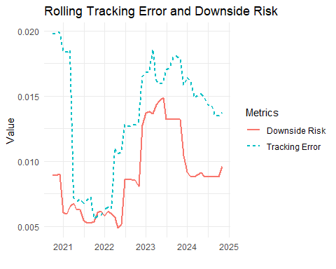
Relative Risk Analysis

Slide 5
Graph/Table: Rolling Tracking Error and Downside Risk
Purpose: Compare the fund’s risk metrics to the benchmark. Metrics to Show: Rolling tracking error (standard deviation of active returns over time). Rolling downside risk (semi-standard deviation or conditional value-at-risk). Visualization: A dual-line chart where one axis shows tracking error and the other shows downside risk over time. This will illustrate the fund’s consistency and risk compared to the benchmark.

Slide 6
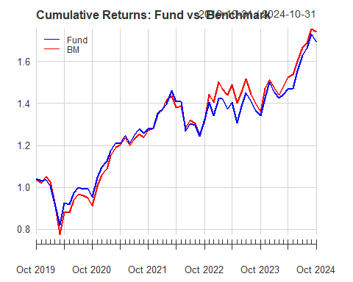
##Relative Performance Graph: Cumulative Returns of Fund vs. Benchmark

Slide 7
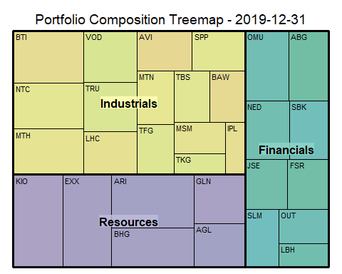
##Fund Positioning

Slide 8
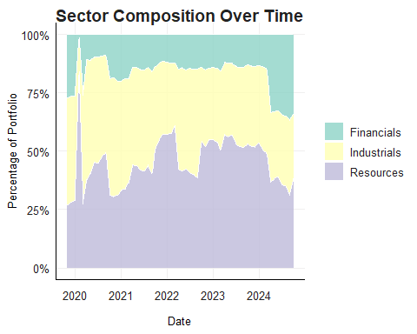
***

Slide 9
##Performance Attribution Graph/Table: Contribution to Active Return by Stock/Sector
Purpose: Break down the relative performance into contributors. Metrics to Show: Attribution of active return (fund return - benchmark return) by stock and by sector. Highlight largest contributors and detractors (positive and negative). Visualization:
Bar chart for sectors: Each bar represents a sector’s contribution to active return. Stacked bar chart or waterfall chart for stocks: Show top contributors and detractors.

